Slide 1




Case 10
CASE 5
Stella
Management of DVT:
A Practical Guide for Primary Practice

Slide 2

Learning Objectives
Upon completion of this activity, participants should be able to:
I
Establish the pre-test probability for deep vein thrombosis (DVT) by history, physical exam and Wells Score tool
II
Select the appropriate diagnostic test(s); D-dimer, and ultrasound (US) in accordance with pre-test probability
III
Describe the difference between proximal and full leg ultrasound
Prescribe initial treatment based on the diagnostic test results for above and below knee (DVT); and select appropriate dose and duration of anticoagulation therapies
IV

Slide 3

Case 10
Stella
35 years old
Stella is a busy Assistant Marketing Director.
She comes in for an appointment complaining of lower leg pain for the past 2 days and some leg swelling which is unlike anything she has experienced before.
She recently returned from a business trip which included a 10 hour flight.
She does not have a cough, shortness of breath, chest or back pain.
Notes:
Speaker Notes:

Slide 4

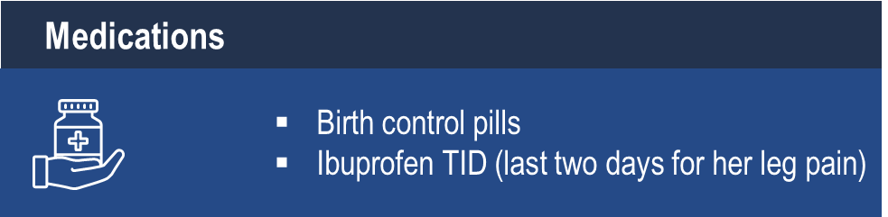
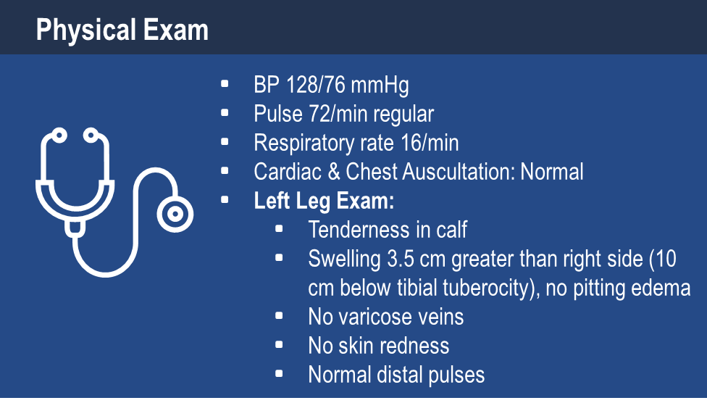
Case 10
Stella
35 years old
Notes:
Speaker Notes:

Slide 5

Using the Two Level Wells Pre-Test, what is Stella’s probability for a DVT diagnosis ?
Select from one of the available options
Likely
Unlikely
Not Sure
Notes:
Speaker Notes:

Slide 6
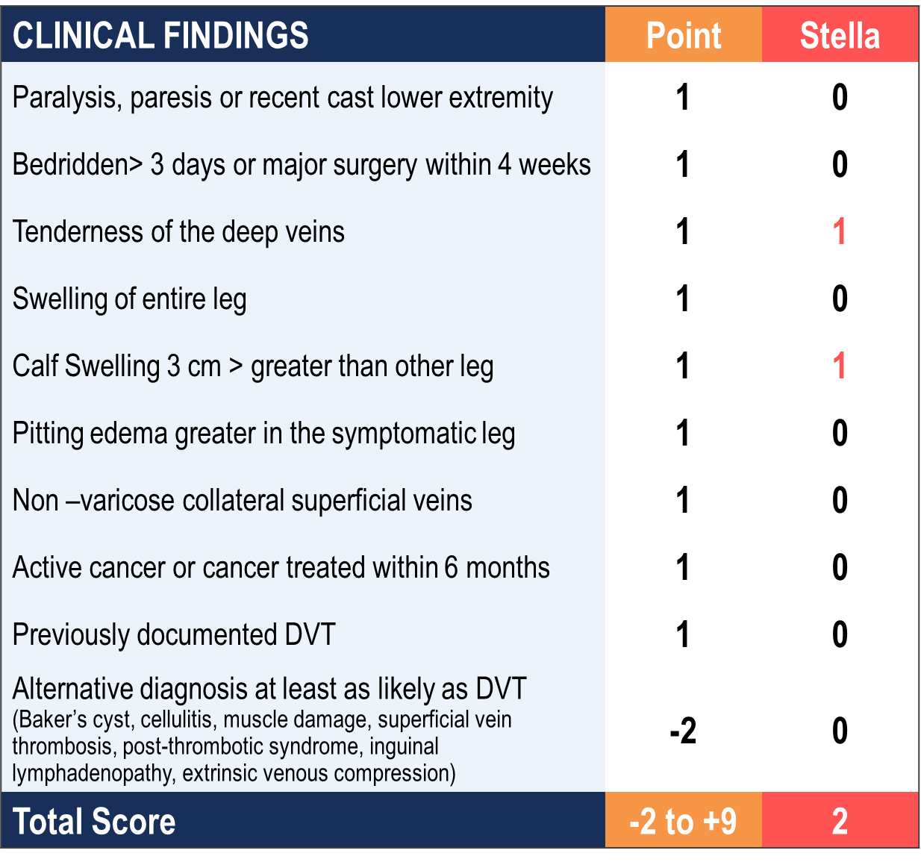
Stella’s Pretest Diagnosis
Two Level Wells Score for DVT Diagnosis
2015 Thrombosis Canada
Notes:
Speaker Notes:
There is also a three level wells score for DVT diagnosis but for simplicity the two level score was used in this case.

Slide 7
Two-Level Pretest Probability
for DVT Diagnosis
Wells Score | Probability of DVT | Likelihood
< 2 | 6% | Unlikely
≥ 2 | 28% | Likely
2015 Thrombosis Canada
Notes:
Speaker Notes:
The two level is useful for treatment decisions (eg. patients at low risk of bleeding with a likely pretest probability should be treated pending ultrasound results), whereas a hs-ddimer can be used to rule out DVT in patients with a moderate pretest probability. If we are going the path of ordering a ddimer for our patient then we should also present the 3 level wells score.The other option would be to recommend CUS on patients with a likely pretest probability, and reserve ddimers for patients with wells scores for less than 2. I think this would be more practical because in the real world, ddimers are not reported by the lab rapidly enough to be used in a family practice.

Slide 8
Case 10
It is now 7:30 pm and Stella is the last patient in your office
Notes:
Speaker Notes:

Slide 9
Which diagnostic test(s) would you order?
Select from one of the available options
D-dimer
Ultrasound
1 & 2
None
Not Sure
Notes:
Speaker Notes:

Slide 10
DVT Diagnostic & Treatment Algorithm
2 Level Wells Probability Score
2 or greater Wells Score
Likely
Ultrasound
First choice: proximal ultrasound
Many centers: full leg ultrasound "automatic"
Bates SM, et al. Diagnosis of DVT: Antithrombotic Therapy and Prevention of Thrombosis, 9th ed:
American College of Chest Physicians Evidence‐Based Clinical Practice Guidelines. Chest 2012;141 (2
Suppl):e351S‐418S.
Notes:
Speaker Notes:
D-dimers are indicated for patients with likely clinical probability but have a negative proximal US. This is because a distal DVT can be missed on a proximal US. However, if the patient had a whole leg compression US that did not show a DVT then no further investigation is indicated.

Slide 11
Case 10
You ordered the ultrasound but you will not get the results until tomorrow or the day after
Notes:
Speaker Notes:

Slide 12
What is your next step in the meantime?
Select from one of the available options
Send Stella to the Emergency Room
Send Stella home without treatment and bring her back review the US once received
Start apixaban 10 mg bid and bring Stella back to review the US once received
Start rivaroxaban 15 mg bid and bring Stella back to review the US once received
Start warfarin and bring Stella back to review the US once received
Start LMWH at therapeutic doses and bring Stella back to review the US once received
Notes:
Speaker Notes:

Slide 13
Starting Anticoagulation in Patients with a likely Pretest Probability of DVT/PE
Anticoagulation should be started immediately* in patients with a likely Pretest Probability of DVT/PE
*2. In patients with DVT of the leg or PE and no cancer, as long-term (first 3 months) anticoagulant therapy, we suggest dabigatran, rivaroxaban, apixaban, or edoxaban over vitamin K antagonist (VKA) therapy (all Grade 2B).
In patients with a high clinical suspicion of acute DVT, we suggest treatment with parenteral anticoagulants compared with no treatment while awaiting the results of diagnostic tests (Grade 2C) .
In patients with an intermediate clinical suspicion of acute VTE, we suggest treatment with parenteral anticoagulants compared with no treatment if the results of diagnostic tests are expected to be delayed for more than 4 h (Grade 2C)
In patients with a low clinical suspicion of acute VTE, we suggest not treating with parenteral anticoagulants while awaiting the results of diagnostic tests, provided test results are expected within 24 h (Grade 2C)
Remarks: Initial parenteral anticoagulation is given
before dabigatran and edoxaban, is not given before rivaroxaban and apixaban, and is overlapped with VKA therapy.
*applies only in patients with a low risk of bleeding
CHEST 2012;141(2_suppl):e419S-e494S
CHEST 2016;149(2):315-352
Notes:
Speaker Notes:

Slide 14
Risks of Untreated DVT
of people with proximal lower extremity DVT will develop PE if not treated
~50%
The mortality rate for PE without treatment is approximately
30%
compared to 1–8% with adequate therapy
DVT, deep vein thrombosis; PE, pulmonary embolism
Ozaki A, Bartholomew JR. Venous Thromboembolism (Deep Venous Thrombosis & Pulmonary Embolism). Available at: http://www.clevelandclinicmeded.com/medicalpubs/diseasemanagement/cardiology/venous-thromboembolism/; Scarvelis D, Well PS. CMAJ 2006; 175:1087-92.
Notes:
Speaker Notes:
Once VTE is suspected, anticoagulation should be started immediately (i.e. before diagnostic test results are available) unless there are contraindications to treatment.
This is because of the high risk of pulmonary embolism if proximal DVT is left untreated (50%); PE occurs in 6-10% of patients after a DVT in the upper extremities and 15-32% following a DVT in the lower extremities.
PE can be fatal, particularly if not treated. Most patients with PE who die do so because of a failure of diagnosis, not because of inadequate therapy. Indeed, treatment reduces the risk of mortality in patients with PE from 30% to 2-8%.
Other complications include post-thrombotic syndrome (PTS) and chronic thromboembolic pulmonary hypertension (CTPH).
References:
Ozaki A, Bartholomew JR. Venous Thromboembolism (Deep Venous Thrombosis & Pulmonary Embolism). Available at: http://www.clevelandclinicmeded.com/medicalpubs/diseasemanagement/cardiology/venous-thromboembolism/.
Scarvelis D, Well PS. Diagnosis and treatment of deep-vein thrombosis. CMAJ 2006; 175:1087-92.

Slide 15

DVT Diagnostic & Treatment Algorithm
2 Level Wells Probability Score
2 or greater Wells Score
Likely
Rx anticoagulation
Ultrasound
First choice: proximal ultrasound
Many centers: full leg ultrasound "automatic"
Bates SM, et al. Diagnosis of DVT: Antithrombotic Therapy and Prevention of Thrombosis, 9th ed:
American College of Chest Physicians Evidence‐Based Clinical Practice Guidelines. Chest 2012;141 (2
Suppl):e351S‐418S.
Notes:
Speaker Notes:

Slide 16
Case 10
You started apixaban last night. Stella comes back to your office the next day to review the results. The proximal US is negative.
Notes:
Speaker Notes:

Slide 17
What would you do now?
Select from one or more of the available options
Stop apixaban & order D-dimer test to rule out DVT
Stop apixaban & order a full leg US (above and below knee)
Continue apixaban & order full leg US
Stop apixaban and conduct no further tests
Notes:
Speaker Notes:
Both 1 and 2 are options
Generally sepaking the clinican will order a leg US to rule out DVT. Depending on the lab, and often radiologist, either a whole leg or proximal D/CUS is donAbove knee (Proximal). e. Generally speaking, below knee D/CUS are not done in isolation. Guidelines recommend proximal US only.

Slide 18
DVT Diagnostic & Treatment Algorithm
2 Level Wells Probability Score
2 or greater Wells Score
Likely
Rx anticoagulation
If a full leg US is negative, there is no need to do a D-dimer or follow-up US as the diagnosis is ruled out.
Proximal
Ultrasound
Negative
Stop anticoagulation
D-Dimer
Bates SM, et al. Diagnosis of DVT: Antithrombotic Therapy and Prevention of Thrombosis, 9th ed:
American College of Chest Physicians Evidence‐Based Clinical Practice Guidelines. Chest 2012;141 (2
Suppl):e351S‐418S.
Notes:
Speaker Notes:
It should be made clear that we only need to do d-diimers or serial leg ultrasounds if the original ultrasound was a proximal US. Many institutions, particularly in Quebec and rural sites, are doing whole leg ultrasound. If a whole leg US is negative, there is no need to do a ddimer or followup US as the diagnosis is ruled out.

Slide 19
D-dimer Test Background
Helps rule out DVT when negative, but of no diagnostic value when positive
D‐dimer is a sensitive but very non‐specific measure of thrombosis. Although D‐dimer is elevated in patients with DVT, it is also elevated in a variety of other common conditions including:
inflammatory diseases
malignancy, pregnancy
surgery
trauma
and advanced age
ThrombosisCanada.ca
Notes:
Speaker Notes:
D‐Dimer
D‐Dimer is a sensitive but very non‐specific measure of thrombosis. Although D‐dimer is elevated in patients with DVT, it is also elevated in a variety of other common conditions including, but not limited to, inflammatory diseases, malignancy, pregnancy, surgery, trauma, and advanced age. This renders the test useful to help rule out DVT when negative, but of no diagnostic value when positive. Although there are several D‐dimer assays available, those that are typically used in Canada are all highly sensitive assays (sensitivity of greater than 90%) and can be used interchangeably in combination with the Wells score to exclude DVT. However, clinicians should check with their laboratory to confirm the status of the D‐dimer assay used. Realistically, community‐based physicians are unlikely to receive timely D‐dimer results from outside laboratories and may not be able to use strategies involving these tests. Alternative management approaches include diagnostic algorithms incorporating pre‐test probability assessment with compression CUS (outlined below) or direct referral to an Emergency Department or Thrombosis Clinic.

Slide 20
What if the original proximal
ultrasound was positive?
Select from one of the available options
Continue apixaban 10 mg bid x 7 days, then 5 mg bid or rivaroxaban 15 mg bid x 21 days, then 20 mg daily
Start LMWH for 5-10 days and switch to dabigatran 150 mg bid or edoxaban 60 mg daily
Start warfarin
Start LMWH + warfarin
Notes:
Speaker Notes:

Slide 21
DVT Diagnostic & Treatment Algorithm
2 Level Wells Probability Score
2 or greater Wells Score
Likely
Rx anticoagulation
Proximal
Ultrasound
DVT
Positive
Continue anticoagulation
Bates SM, et al. Diagnosis of DVT: Antithrombotic Therapy and Prevention of Thrombosis, 9th ed:
American College of Chest Physicians Evidence‐Based Clinical Practice Guidelines. Chest 2012;141 (2
Suppl):e351S‐418S.
Notes:
Speaker Notes:

Slide 22
What if the original ultrasound was a full leg ultrasound and it was negative ?
Select from one of the available options
Stop apixaban & order D-dimer test to rule out DVT
Stop apixaban & order a repeat full leg US (above and below knee)
Stop apixaban and conduct no further tests
Other
Notes:
Speaker Notes:
Correct Answer: 3

Slide 23
DVT Diagnostic and Treatment Algorithm
Assuming initial U/S was a full leg U/S
2 Level Wells Probability Score
2 or greater Wells Score
Likely
Rx anticoagulation
Full leg ultrasound
Stop anticoagulation
Negative
Positive (distal)
Positive (proximal)
Continue anticoagulation
No DVT
Distal DVT
Proximal DVT
Continue anticoagulation* or serial US in 1-2 weeks
*If patient has severe symptoms or risk factors for extension
DVT, deep vein thrombosis; US, ultrasound
Adapted from: Thrombosis Canada. Deep Vein Thrombosis: Diagnosis. Available at: http://thrombosiscanada.ca/?page_id=18#.
Notes:
Speaker Notes:
This algorithm describes the proposed management strategy when the initial US is a full-leg compression ultrasound (CUS).
While a negative full-leg CUS excludes DVT, management is uncertain if there is a positive isolated calf DVT; options include:
Treatment, which is generally warranted if the patient is very symptomatic and at low risk of bleeding, or if they have risk factors for clot extension (e.g. positive D-dimer, calf DVT that is extensive or close to the proximal veins, absence of a reversible provoking risk factor, cancer, previous VTE, lower extremity immobilization, and in-patient status)
Repeat (serial) CUS after 1 to 2 weeks, after which time extension is not likely – this is considered an alternative if the patient is not very symptomatic or at high risk of clot extension
Distal vein imaging is not usually recommended.
Treatment is also warranted for patients who are unlikely or unable to return for follow-up (serial) testing.
Reference:
Thrombosis Canada. Deep Vein Thrombosis: Diagnosis. Available at: http://thrombosiscanada.ca/?page_id=18#.

Slide 24
DVT Diagnostic and Treatment Algorithm
Assuming initial U/S was a full leg U/S
2 Level Wells Probability Score
<2 Wells Score
2 or greater Wells Score
Unlikely
Likely
Initiate treatment
D-Dimer
Prox. US
Negative
Positive
Positive
Negative
Discontinue treatment
No DVT
Prox. US
DVT
D-Dimer
Negative
Positive
Negative
Positive
No DVT
DVT
No DVT
Serial US
or whole leg US
*DVT, deep vein thrombosis; US, ultrasound
Adapted from: Thrombosis Canada. Deep Vein Thrombosis: Diagnosis. Available at: http://thrombosiscanada.ca/?page_id=18#.
Notes:
Speaker Notes:
The initial evaluation of patients with a suspected DVT should include a history, physical exam, and an established prediction model (e.g. two-level Wells score).
If the clinical pretest probability is unlikely, a high-sensitivity D-dimer test should be performed:
If this is negative, the patient does not likely have DVT and no further testing is required.
If the D-dimer test is positive, then a proximal leg compression ultrasound is warranted.
If the clinical pretest probability is likely:
Anticoagulation treatment can be initiated immediately with a rapid-acting anticoagulant until diagnostic testing is performed, unless they are at high risk of bleeding or have contraindication(s) to anticoagulant therapy.
A proximal ultrasound should then be conducted and if positive, anticoagulation should be continued; if negative, then a D-dimer test is indicated.
D-dimers are indicated for patients with a likely clinical probability of DVT but have a negative proximal ultrasound because a distal DVT can be missed on a proximal ultrasound.
If the D-dimer test is positive, serial ultrasound or whole leg ultrasound should be conducted to confirm DVT.
However, if the patient had a whole leg compression ultrasound that did not show a DVT, then no further investigation is indicated.
Whole leg compression ultrasound is an option (rather than proximal ultrasound) to eliminate the need for serial studies.
It should also be noted that D-dimer is a sensitive but non-specific test for thrombosis (i.e. it is elevated in many conditions besides DVT).
High-sensitivity D-dimer tests are typically used in Canada (i.e. sensitivity for DVT >90%); however, clinicians should check with their local lab to confirm which D-dimer test is used.
If access to high-sensitivity D-dimer testing is limited (or significant delays are expected), community physicians may directly refer patients to the emergency department or thrombosis clinic.
Reference:
Thrombosis Canada. Deep Vein Thrombosis: Diagnosis. Available at: http://thrombosiscanada.ca/?page_id=18#.

Slide 25
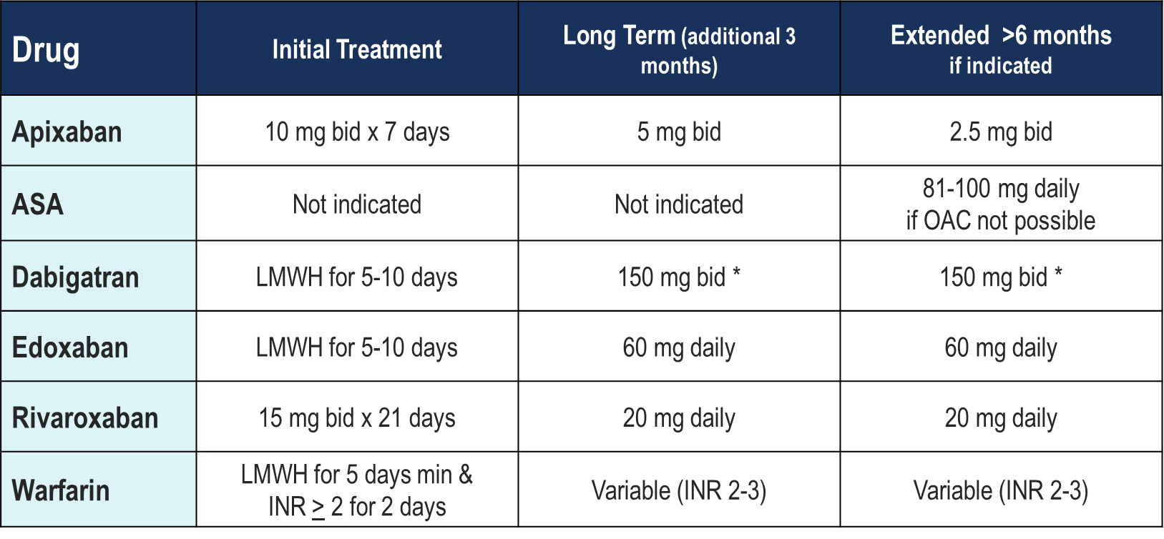
Antithrombotic Dosing in VTE
*(110 mg bid if age≥80, or age≥75 + higher risk of bleeding, including CrCl 30-50 mL/min)
Pfizer Canada Inc./BMS Canada. Eliquis (apixaban) Product Monograph, June 16, 2016. Bayer Inc. Xarelto (rivaroxaban) Product Monograph. July 20, 2015.
Boehringer Ingelheim Canada Ltd. Pradaxa (dagbatran) Product Monograph. August 11, 2016.
Daiichi Sankyp Inc. Lixiana (edoxaban) Product Monograph. November 2, 2016.
Thrombosis Canada Clinical Guide. Deep Vein Thrombosis (DVT): Tretament. www.thrombosiscanada.ca
Notes:
Speaker Notes:
Apixaban
10 mg taken orally twice daily for 7 days, followed by 5 mg taken orally twice daily
Apixaban is approved for the treatment of DVT and/or PE and for the prevention of recurrent DVT and PE.
Dosing: 10 mg PO twice daily for the first 7 days, followed by 5 mg twice daily.
> 6 months of treatment, consideration can be given to reducing the dose to 2.5 mg PO twice daily for long‐term prevention of recurrent VTE.
Apixaban should not be used in women who are pregnant or breast‐feeding, patients with a CrCl <15mL/min or on dialysis, or patients with severe liver disease.
Rivaroxaban
Rivaroxaban is an oral anticoagulant that works through direct inhibition of clotting Factor Xa. In Canada, rivaroxaban is approved for the treatment of DVT and/or PE and for the prevention of recurrent DVT and PE as a simple, non‐parenteral treatment option. For many primary care physicians not comfortable with the use of LMWH, or not having the necessary time and resources to teach patients self‐injection, rivaroxaban may enable treatment of confirmed VTE without the need to refer to emergency rooms, resulting in more rapid treatment initiation, greater convenience for the patient and physician, as well as potentially reducing health care costs. It is also valuable for patients not willing to accept or unable to manage self‐injection.
· Dosing: 15 mg PO twice daily for the first 21 days, followed by 20 mg once daily for the duration of treatment.
· Rivaroxaban should not be used in women who are pregnant or breast‐feeding, patients with a CrCl <30mL/min, or patients with severe liver disease.
Dabigatran
Dabigatran is an oral anticoagulant that works through direct inhibition of clotting Factor IIa thrombin). In Canada, dabigatran is approved for the treatment of acute DVT and/or PE after a 5‐10 day initial treatment period with a parenteral anticoagulant (usually a LMWH) and for the prevention of recurrent DVT and PE.
· Dosing: 150 mg PO twice daily for the duration of treatment.
· Dabigatran should not be used in women who are pregnant or breast‐feeding, or patients with a CrCl <30mL/min.
ASA
ASA should not be used for initial treatment of VTE and provides less protection than continued anticoagulation for extended treatment. Two extended treatment studies of patients with a first unprovoked DVT demonstrated that low‐dose ASA provided benefit over placebo for patients having completed 6‐18 months of anticoagulation.
Warfarin:
Initial treatment with warfarin should be combined with an immediate‐acting agent such as LMWH for at least 5 days and until the INR reaches at least 2.0 for two consecutive days. Initial dosing is best guided by using standardized nomograms for best results. Frequent monitoring is required until a stable, in‐range INR is reached, after which reduced frequency of testing is appropriate. Warfarin is associated with many drug and food interactions that affect INR. Alcohol and a number of health supplements (e.g. St. John’s Wort) can also change the INR. Alterations in concomitant medications and new concurrent illness should be associated with INR testing. Patients should not reduce intake of foods high in vitamin K, but should be encouraged to maintain a consistent diet.
LMWH
Dalteparin (Fragmin®): 200 U/kg SC once daily (preferred) or 100 U/kg SC twice daily. Enoxaparin (Lovenox®): 1.5 mg/kg SC once daily or 1 mg/kg SC twice daily.
Tinzaparin (Innohep®): 175 U/kg SC once daily.
· The dose of LMWH is generally rounded up to the nearest pre‐filled syringe dose.
· For obese patients, the dose of LMWH is based on their actual body weight (and not capped at 18,000 U/day).
· For patients with severe renal insufficiency (creatinine clearance <30 mL/min), clinical data on the use of LMWH for the treatment of VTE are limited and LMWHs should be used with caution (or avoided). If used, the dose of LMWH should be reduced. If LMWH is to be used long‐term in the setting of severe renal insufficiency, monitoring with anti‐factor Xa levels may be required.

Slide 26
Treatment Options in 2019
LMWH alone
LMWH
Warfarin Bridge (LMWH warfarin bridge)
LMWH
LMWH 5 days min. &
2 consecutive days of INR > 2
Warfarin
DOAC (apixaban/rivaroxaban)
apixaban (AMPLIFY)
rivaroxaban (EINSTEIN-DVT)
rivaroxaban (EINSTEIN-PE)
DOAC
dabigatran (RE-COVER)
dabigatran (RE-COVER II)
edoxaban (HOKUSAI-VTE)
LMWH – dabigatran/edoxaban switch
LMWH
5 -10 days
DOAC
Notes:
Speaker Notes:

Slide 27
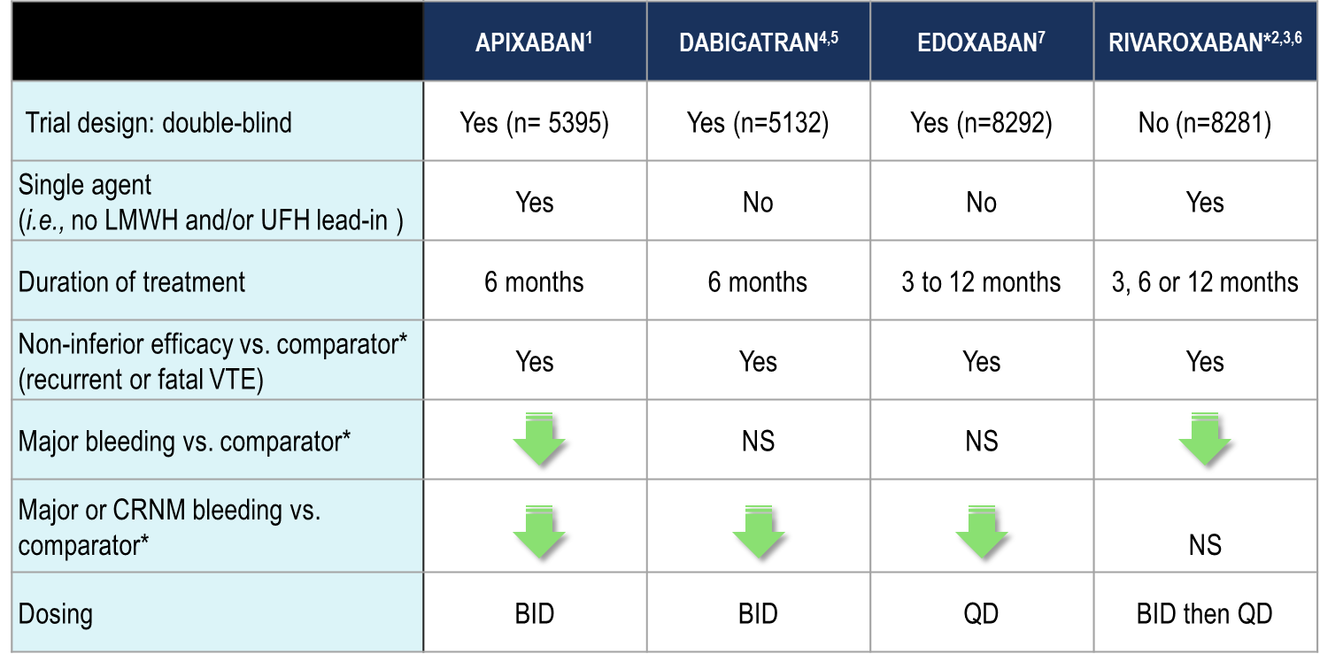
Overview: Indirect Comparisons of DOAC Trials for Acute VTE Treatment
Significant Reduction p<0.05
NS = no significant difference
*Pooled analysis
To date there are no head-to-head trials between DOACs, therefore comparative efficacy and safety have not been established
*Comparator was LMWH or UFH followed by either a VKA (warfarin or acenocoumarol) in the rivaroxaban trials or warfarin in the other NOAC trials.
Agnelli G, et al. N Engl J Med 2013; 369:799-808. 2. The EINSTEIN Investigators. New Engl J Med 2010; 363:2499-510. 3. The EINSTEIN-PE Investigators. New Engl J Med 2012; 366:1287-97. 4. Schulman S, et al. N Engl J Med 2009; 361:2342-52. 5. Schulman S, et al. Blood (ASH Annual Meeting Abstracts) 2011; 118: Abstract 205. 6. Prins et al. Thrombosis Journal 2013, 11:21 http://www.thrombosisjournal.com/content/11/1. 7. The HOKUSAI-VTE Investigators. N Engl J Med. 2013; 369:1406-15.
Notes:
Speaker Notes:

Slide 28
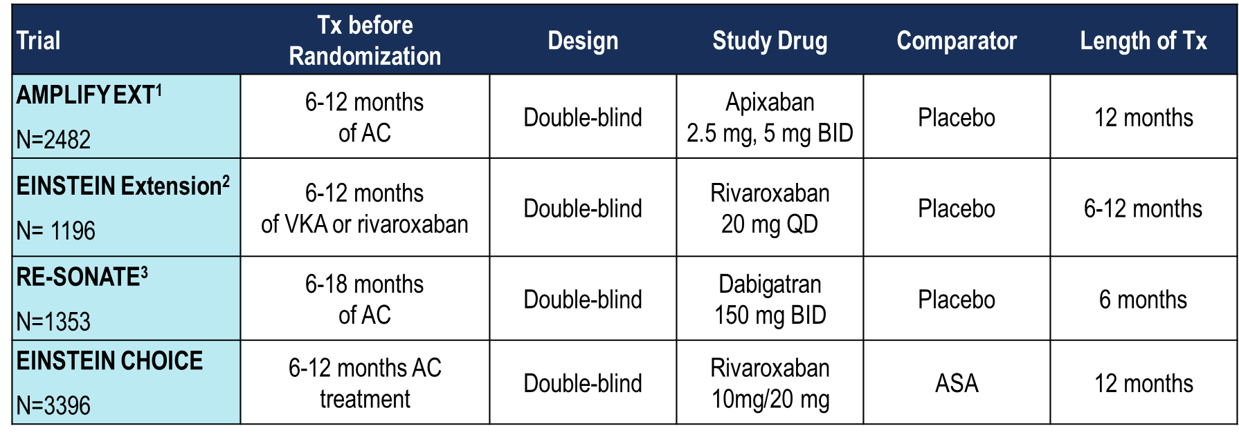
DOAC Clinical Trial Designs
for Extended VTE Treatment
Agnelli G. et al. New England J Med 2013; 368: 699-708
The EINSTEIN Investigators New England J Med 2010; 363: 2499-5101.
Schulman S. et al. New England J Med 2013; 368: 709-18
Notes:
Speaker Notes:
For edoxaban: a post-hoc analysis of the Hokusai-VTE study was undertaken. Lancet Haematol 2016; 3: e228–36
Methods The Hokusai-VTE trial (NCT00986154) was a randomised, double-blind, event driven non-inferiority trial in 8292 patients comparing edoxaban with warfarin in the treatment of patients with acute venous thromboembolism. All patients were treated for at least 3 months and treatment was continued for up to 12 months. The outcomes at 12 months were documented in all patients irrespective of treatment duration. 3633 patients treated with edoxaban and 3594 treated with warfarin who completed 3 months of treatment were eligible for this analysis. The primary efficacy outcome was the incidence of adjudicated symptomatic recurrent venous thromboembolism evaluated for each of the time intervals of 3 months, greater than 3 months to 6 months, greater than 6 months to less than 12 months, and at 12 months, as well as the cumulative incidence occurring between 3 and 12 months. The principal safety outcome was the incidence of clinically relevant bleeding (composite of major or clinically relevant non-major bleeding). Both on-treatment and intention-to-treat analyses were done.

Slide 29
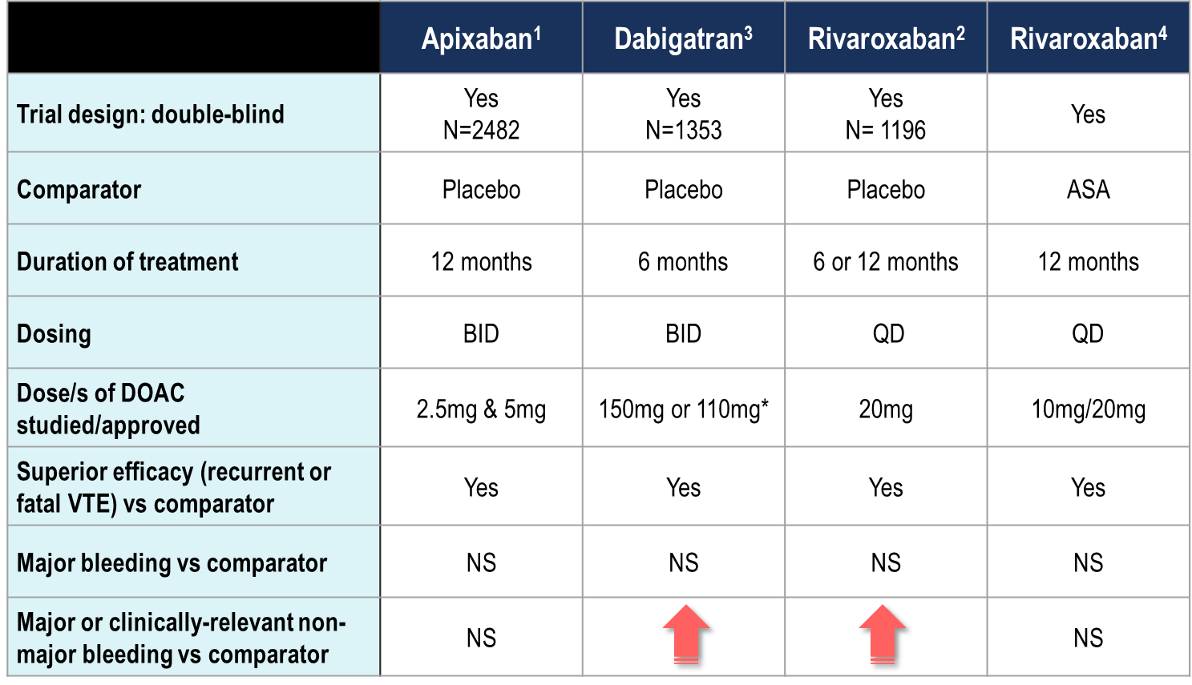
Indirect Comparisons Overview: DOAC Trials for Extended VTE Treatment ≥ 6 months
NS = no significant difference
Significant increase p<0.05
*not studied
To date there are no head-to-head trials between DOACs, therefore comparative efficacy and safety have not been established
Agnelli G et al. N Engl J Med 2013; 368: 699-708 4 Weitz JL et all, N. Engl. J. Med. 2017.
The EINSTEIN Investigators. N Engl J Med. 2010;363:2499-2510
Schulman S et al. N Engl J Med. 2013; 368:709-718
Notes:
Speaker Notes:
For edoxaban: a post-hoc analysis of the Hokusai-VTE study was undertaken. Lancet Haematol 2016; 3: e228–36
Findings In the on-treatment analysis, the incidence of recurrent venous thromboembolism at 3 months was 1.1% (0.8–1.4; 44 of 4118 patients) in the edoxaban-treated group versus 1.2% (0.9–1.6; 51 of 4122) in the warfarin-treated group; between greater than 3 months and 6 months, 0.7% (0.3–1.5; eight of 1076) versus 0.5% (0.2–1.1; fi ve of 1084); between greater than 6 months and less than 12 months, 0.2% (0.0–0.8; two of 896) versus 0.8% (0.03–1.7; seven of 851); and at 12 months, <0.1% (0.0–0.3; one of 1661) versus 0.1% (0.0–0.4; two of 1659). In the on-treatment analysis, the cumulative incidence of recurrent venous thromboembolism between 3 and 12 months was 0.3% (95% CI 0.2–1.5; 11 of 3633 patients) in the edoxaban-treated group and 0.4% (0.2–1.7; 14 of 3594) in the warfarin-treated group (HR 0.78, 95% CI 0.36–1.72). The cumulative incidence of clinically relevant bleeding (major or non-major) between 3 and 12 months was 3.9% (95% CI 3.3–4.6; 143 of 3633 patients) in the edoxaban-treated group and 4.1% (3.5–4.8; 147 of 3594 patients) in the warfarin-treated group (HR 0.97, 95% CI 0.77–1.22); cumulative incidence of major bleeding was 0.3% (95% CI 0.2–0.5; 11 of 3633 patients) in the edoxaban-treated group and 0.7% (0.4–1.0; 24 of 3594 patients) in the warfarin-treated group (HR 0.45, 95% CI 0.22–0.92). Similar results were obtained in the intention-to-treat analysis.
Interpretation Extended treatment with edoxaban is effective and associated with less major bleeding than warfarin. Edoxaban once daily provides an attractive alternative to warfarin for patients with venous thromboembolism who require extended treatment for prevention of recurrent venous thromboembolism.

Slide 30
CHEST Recommendations on Duration of Anticoagulant Therapy for DVT
3 months
Extended
Provoked DVT
Unprovoked distal DVT
≥1 unprovoked proximal DVT
DVT, deep vein thrombosis
Kearon C et al. Chest 2016; 149:315-52.
Notes:
Speaker Notes:
According to the American CHEST AT10 guidelines, the minimum duration of anticoagulant therapy for VTE is usually 3 months (i.e. « long-term therapy »).
A decision to treat patients for longer than 3 months (i.e. « extended therapy ») with no scheduled stopping date usually implies that anticoagulant therapy will be continued indefinitely.
Decisions to extend therapy beyond 3 months should take into consideration the type of VTE (proximal or distal DVT or PE; provoked or unprovoked) and risk of bleeding.
In all patients who receive extended anticoagulant therapy, the continued use of treatment should be reassessed annually.
Reference:
Kearon C et al. Antithrombotic therapy for VTE disease: CHEST guideline and expert panel report. Chest 2016; 149:315-52.

Slide 31
Duration of Anticoagulant Therapy
for DVT
Categories of VTE | Duration of Treatment
Provoked by a transient risk factor* | 3 months
First unprovoked VTE† | Minimum of 3 months and then reassess
Proximal DVT or PE with no or only minor risk factors for bleeding | Indefinite therapy with annual review, depending on patient preference
Isolated distal DVT | 3 months
Second unprovoked VTE | Minimum of 3 months, then reassess. For patients with no or only minor risk factors for bleeding, indefinite therapy with annual review‡
Cancer-associated VTE | Minimum 3 months, then reassess and continue if active cancer (overt evidence of cancer) or continuing to receive anticancer therapy
* eg. surgery, hospitalization or plaster cast immobilization, all within 3 months; estrogen therapy, pregnancy, leg injuries or immobilizations more recently (e.g. within 6 weeks).
† Absence of a transient risk factor or active cancer
‡ Indefinite therapy is suggested if there is a low or moderate risk of bleeding, and 3 months is suggested if there is a very high risk of bleeding; both of these decisions are sensitive to patient preference.
Thrombosis Canada Clinical Guide. Venous Thromboembolism: Duration of Treatment. www.thrombosiscanada.ca Anticoagulant Therapy for Venous Thromboembolism, http://thrombosiscanada.ca/?page_id=18#
Notes:
Speaker Notes:

Slide 32
Proposed Categorization of Provoked / Unprovoked Risk Factors by the ISTH (2016)
Provoked by a transient major risk factor
Surgery with general anesthesia for >30 min
Confined to bed in hospital (“bathroom privileges” only) for ≥3 days with an acute illness
Cesarean section
Provoked by a minor yet important transient risk factor
Surgery with general anesthesia for <30 min
Air travel>8 hours
Admission to hospital for <3 days with acute illness
Estrogen therapy
Pregnancy or puerperium
Confined to bed out of hospital for ≥3 days with acute illness
Leg injury associated with reduced mobility for ≥3 days
Unprovoked or provoked by a persistent risk factor
Cancer
Inflammatory bowel disease
ACCP guidelines recommend at least 3 months’ anticoagulant therapy after provoked VTE with transient risk factors or longer after unprovoked (idiopathic) or VTE provoked by irreversible factors
1%
5%
10%
Annual recurrence risk
!
Patients with a major risk factor are considered to have provoked VTE
ISTH, International Society on Thrombosis and HaemostasisKearon C et al. J Thromb Haemostasis 2016; 14:1480-3.
Notes:
Speaker Notes:
A recent publication by the ISTH proposes categorizing transient risk factors for DVT based on the following definitions:
Risk factors are considered ‘major’ if they have been shown to be associated with:
Half the risk of recurrent VTE after stopping anticoagulant therapy (compared with if there was no transient risk factor), when the risk factor occurred up to 3 months before the VTE, or
>10-fold increase in the risk of having a first VTE
Risk factors are considered ‘minor’ if they have been shown to be associated with:
Half the risk of recurrent VTE after stopping anticoagulant therapy (compared with if there was no transient risk factor), when the risk factor occurred up to 2 months before the VTE, or
3-10-fold increase in the risk of having a first VTE
The results of this effort are shown on this slide.
Reference:
Kearon C et al. Categorization of patients as having provoked or unprovoked venous thromboembolism: guidance from the SSC of ISTH. J Thromb Haemostasis 2016;14:1480–3.

Slide 33
Case 10
What if Stella has a proximal DVT related to a flight, but was not on the OCP.
Notes:
Speaker Notes:

Slide 34
How long should Stella be anticoagulated for?
Select from one or more of the available options
3 months
6 months
12 months
Indefinitely
Not Sure
Notes:
Speaker Notes:
1 & 4

Slide 35
Patients with First Unprovoked Proximal DVT – What to Do?
Patients with low bleeding risk:
Generally, men with unprovoked DVT are at high risk and deserve extended anticoagulation
Women with unprovoked DVT can be risk-stratified using the recently validated HERDOO2 rule:
Anticoagulation can be stopped after three months in low risk women (HERDOO2 score of 0–1)
Extended anticoagulation is justified in high risk women (HERDOO2 score ≥2)
Patients with high bleeding risk:
Usually 3 months of anticoagulation, then stop
Patient preference must be taken into account
DVT, deep vein thrombosis
Rodger MA et al. CMAJ 2008; 179:417-26.
Notes:
Speaker Notes:
The most common and difficult decision about whether to stop anticoagulant treatment after 3 months or to use extended therapy is in patients with a first unprovoked proximal DVT or PE without a high risk of bleeding.
In these patients, factors such as sex and D-dimer level measured ~1 month after stopping anticoagulant therapy can help stratify risk of recurrent VTE.
Men are at ~75% higher risk of recurrent VTE than women.
Patients with a positive D-dimer result have ~2-fold higher risk than those with a negative result
The HERDOO2 score is useful in women with a first unprovoked VTE to identify those at low risk of recurrence (score 0 or 1) who can safely discontinue treatment.
Patients are considered to be at high risk of bleeding on anticoagulant therapy if they have two or more bleeding risk factors (annual risk of major bleeding is ≥6.5% in these patients).
In all patients who receive extended anticoagulant therapy, the continued use of treatment should be reassessed annually.

Slide 36
HERDOO2 Score
Can identify women with unprovoked VTE who can safely discontinue anticoagulation after 5–7 months
HERDOO2 Scoring
Any hyperpigmentation, edema or redness in either leg | 1 point
VIDAS® D-dimer ≥250 µg/L | 1 point
Obesity (BMI ≥30 kg/m²) | 1 point
Older age (≥65 years) | 1 point
Low risk: 0 or 1 point
High risk: ≥2 points
BMI, body mass index; VTE, venous thromboembolism
Rodger MA et al. CMAJ 2008; 179:417-26.
Notes:
Speaker Notes:
This study aimed to identify factors that are predictive of low annual risk of recurrent VTE (<3%) after taking an oral anticoagulant for 5 to 7 months following an initial unprovoked VTE.
A prospective clinical decision-rule derivation cohort study and a split-sample validation study were performed in 665 consecutive unselected patients presenting with a first, objectively proven unprovoked DVT or PE.
Hyperpigmentation, edema or redness; D-dimer levels; obesity; and older age (HERDOO2) were independently associated with risk of recurrent VTE in women, but not in men.
Thus in women:
The presence of 0 or 1 of the HERDOO2 risk factors was associated with an annual risk of VTE recurrence of 1.6%.
Women with 2 or more risk factors had a 14.1% risk of recurrence.
These findings suggest that women who have taken oral anticoagulants for 5 to 7 months following an initial unprovoked VTE may safely discontinue treatment if they have one or fewer of the risk factors that make up the HERDOO2 score.
Reference:
Rodger MA et al. Identifying unprovoked thromboembolism patients at low risk for recurrence who can discontinue anticoagulant therapy. CMAJ 2008; 179:417-26.

Slide 37
The HERDOO2 Score Predicts Recurrent VTE in Women
In a prospective study of 2785 patients with unprovoked VTE who were treated for 5–7 months and followed for one year:
Conclusion: The authors concluded that this rate (3%) is low enough to justify stopping anticoagulation therapy after a standard course for women with a HERDOO2 score of ≤1.
!
p = NS
p <0.05
NS, no significant difference; VTE, venous thromboembolism
Rodger MA et al. CMAJ 2008; 179:417-26.
Notes:
Speaker Notes:
This study aimed to prospectively validate the HERDOO2 clinical decision rule for identifying women who can safely discontinue oral anticoagulant therapy 5-7 months after an initial unprovoked VTE.
3155 consecutive patients presenting with an initial unprovoked VTE who completed 5-12 months of anticoagulant treatment were eligible for this study; of the 2785 who were enrolled, 51% of women were classified as low risk for recurrent VTE (HERDOO2 score of 0 or 1) and discontinued anticoagulant treatment.
Among the low-risk women who discontinued treatment, the annual rate of recurrent VTE was 3.0%.
Among the high-risk women or men, the annual rate of recurrent VTE was 8.1% in those who discontinued anticoagulant treatment and only 1.6% in those who continued treatment; the incidence of recurrent VTE in the high-risk group was similar among women and men.
The HERDOO2 was concluded to be a valid tool to guide decisions to discontinue oral anticoagulant therapy in women following an initial unprovoked VTE.
Reference:
Rodger MA et al. Validating the HERDOO2 rule to guide treatment duration for women with unprovoked venous thrombosis: multinational prospective cohort management study. BMJ 2017; 356: j1065.

Slide 38
Case 10
What if Stella is found to have an isolated Distal DVT (Full leg u/s)?
Notes:
Speaker Notes:

Slide 39
Which of the following would be correct?
Select from one available options
Tell Stella she is fine and can go on her impending road trip
Definitely start her on anticoagulation
Repeat Proximal u/s in 5-7 days
Anticoagulate her if she has high risk criteria
2&3
3&4
Notes:
Speaker Notes:
Correct Answer: 6 - 3&4

Slide 40
CHEST 2016: Management of Distal DVT
If isolated distal DVT is diagnosed, there are 2 management options:
Treat patients with anticoagulant therapy
Do serial US after 1-2 weeks and treat patients if there is extension of their DVT
CHEST 2016 and Thrombosis Canada guidelines suggest, in patients with acute isolated distal DVT of the leg and:
Without severe symptoms or risk factors for extension, serial imaging of the deep veins for 2 weeks over anticoagulation (Grade 2C)
With severe symptoms or risk factors for extension, anticoagulation over serial imaging of the deep veins (Grade 2C)
DVT, deep vein thrombosis; US, ultrasound
Kearon C et al. Chest 2016; 149:315-52; Thrombosis Canada. Deep Vein Thrombosis (DVT): Treatment. Available at: http://thrombosiscanada.ca/clinicalguides/#.
Notes:
Speaker Notes:
The management of distal DVT is less well studied and decisions to anticoagulate (or not) remain controversial.
The American and Canadian guidelines acknowledge that patients at high risk of bleeding may benefit from serial imaging of the deep veins to monitor for extension of the distal DVT.
If the thrombus extends but remains confined to the distal veins, anticoagulant therapy is suggested, since distal DVT is less likely to embolize and more likely to spontaneously resolve (85%) than proximal DVT
If the distal DVT is found to extend to the proximal veins during serial imaging, then anticoagulation therapy is recommended.
Patients who wish to avoid the inconvenience of repeat imaging and do not object to the inconvenience of treatment – and who are not at high risk of bleeding – may prefer to choose initial anticoagulation over serial imaging.
The same anticoagulants are recommended for distal DVT as for proximal DVT.
Since ~15% of untreated isolated distal DVT subsequently extend into the popliteal vein and may result in PE, it is not acceptable to neither anticoagulate nor monitor serially for 1-2 weeks.
References:
Kearon C et al. Antithrombotic therapy for VTE disease: CHEST guideline and expert panel report. Chest 2016; 149:315-52.
Thrombosis Canada. Deep Vein Thrombosis (DVT): Treatment. Available at: http://thrombosiscanada.ca/clinicalguides/#.

Slide 41
Distal DVT: Risk Factors for Extension (CHEST 2016)
D-dimer is positive (particularly when markedly so without an alternative reason)
Thrombosis is extensive (e.g., >5 cm in length, involves multiple veins, >7 mm in maximum diameter)
Thrombosis is close to the proximal veins
There is no reversible provoking factor for DVT
Active cancer
History of VTE
Inpatient status
DVT, deep vein thrombosis; VTE, venous thromboembolism
Kearon C et al. Chest 2016; 149:315-52; Thrombosis Canada. Deep Vein Thrombosis (DVT): Treatment. Available at: http://thrombosiscanada.ca/clinicalguides/#.
Notes:
Speaker Notes:
Several risk factors associated with higher risk of DVT extension or propagation have been identified, as listed on this slide.
If anticoagulation treatment is initiated, the recommended duration of treatment is 3 months.
Extended duration of anticoagulation is generally not indicated as distal DVT is less likely to recur in the future, compared with proximal DVT and PE.
Reference:
Kearon C et al. Antithrombotic therapy for VTE disease: CHEST guideline and expert panel report. Chest 2016; 149:315-52.
Thrombosis Canada. Deep Vein Thrombosis (DVT): Treatment. Available at: http://thrombosiscanada.ca/clinicalguides/#.

Slide 42
Expert Opinion; DOAC and Acute VTE Caveats and Dosing Considerations
Since we do not dose adjust DOACs in patients with VTE we need to be cognisant of patients in whom drug levels may vary:
extremes of weight (< 50 kg or > 120 kg)
elderly (age >80)
renal insufficiency (CrCl < 30mL/min)
Notes:
Speaker Notes:

Slide 43

Key Messages
Patients presenting with symptoms of DVT in primary care should be stratified using a Wells Score into “likely” or “unlikely” to guide diagnostic and treatment strategies.
Patients with 2 or more points on the Wells Score have a high pretest probability of DVT and should be started on anticoagulation empirically while awaiting US results (except those at high risk of bleeding).
Distal DVT tends to resolve spontaneously so anticoagulation is indicated only in cases of high risk of extension, or if patient is at low risk of bleeding and is symptomatic with distal DVT
Notes:
Speaker Notes:

Slide 44
Key Messages (cont’d)
Initial treatment should have an immediate anticoagulant effect. Warfarin monotherapy is not appropriate initially.
Patients with < 2 on a two level Wells Score have a low enough pretest probability that a d-dimer can rule out DVT
In the treatment of VTE, the NOACs are as effective as and safer than a LMWH bridge to warfarin.
Notes:
Speaker Notes:

Slide 45
Backup Slides

Slide 46

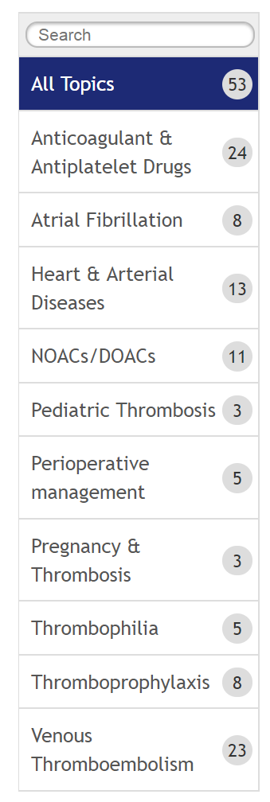
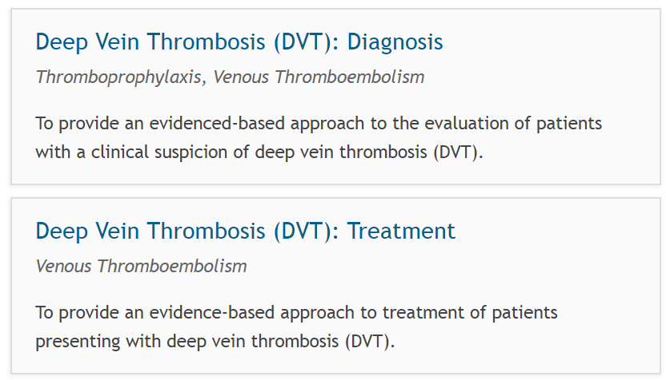
Notes:
Speaker Notes:

Slide 47


www.thrombosiscanada.ca
@ThrombosisCan
Notes:
Speaker Notes:

Slide 48

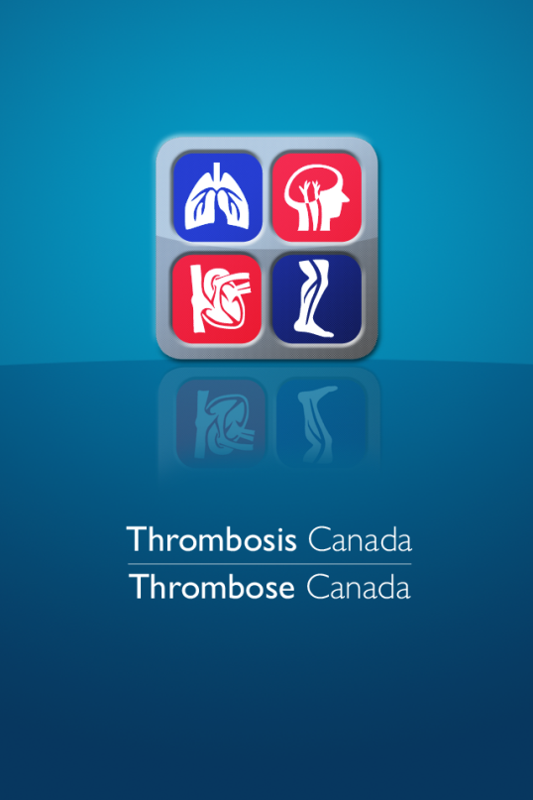
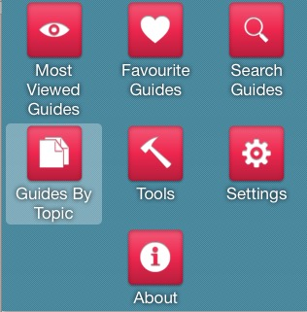
Notes:
Speaker Notes:

